Slide 1
Opportunities for Educational Collaboration Between New Hampshire and Ireland
Michele Dillon
NH-Ireland Trade Council
6/20/25

Slide 2
Ireland – in context
Ireland/Republic of Ireland (26 counties); independent sovereign state (1922); EEC/EU member since 1973
5.38 million people
Northern Ireland (6 counties); part of the United Kingdom {non-EU}
1.92 million people
Different legal jurisdiction; different economic, political, & educational structures
Different religious and cultural history
Many younger people lean toward identifying as both British and Irish

Slide 3
Age Structure
Ireland (5.38M pop.)
Northern Ireland (1.92M pop.)
0-14 years: 20%
15-64: 65%
65+: 15%
0-14 years: 19%
15-64: 64%
65+: 17%

Slide 4
College completion by age group, Ireland and EU-27 average (2024)
% of persons
 | Bachelor degree or higher
Age Group | Ireland | EU-27 Average
25-34 | 64 | 41
35-44 | 60 | 39
45-54 | 53 | 31
55-64 | 37 | 24
Source: CSO & Eurostat

Slide 5
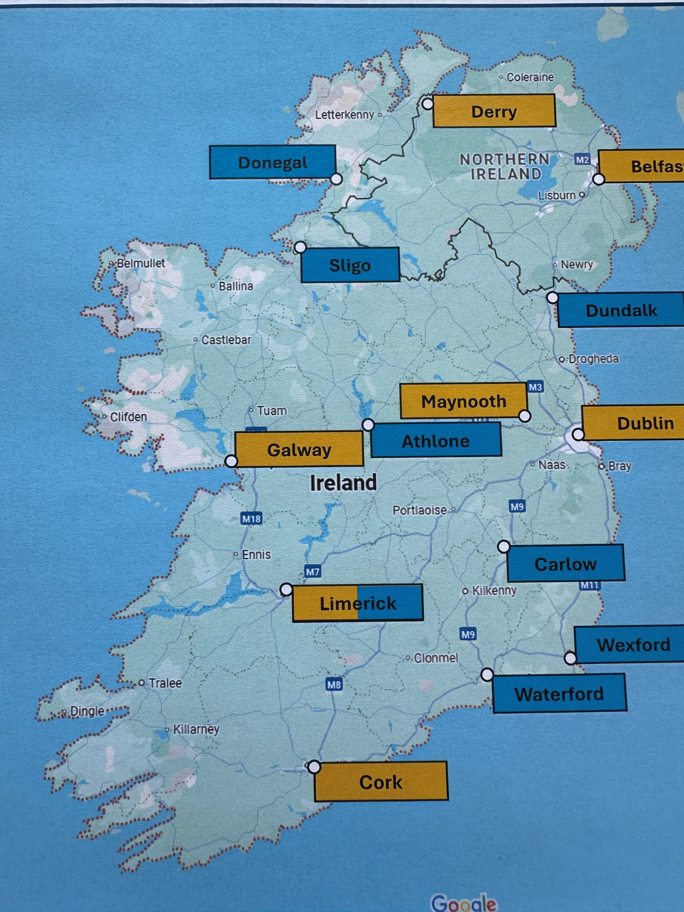

Slide 6
Irish Academic/Research Universities
University College Dublin (1854): 35K students
Trinity College Dublin (1592): 18K students
Dublin City University (1989): 19K students
Maynooth University (1795/1997): 15K students
University College Cork (1845): 23K students
University of Galway (1845): 19K students
University of Limerick (1972): 18K students

Slide 7
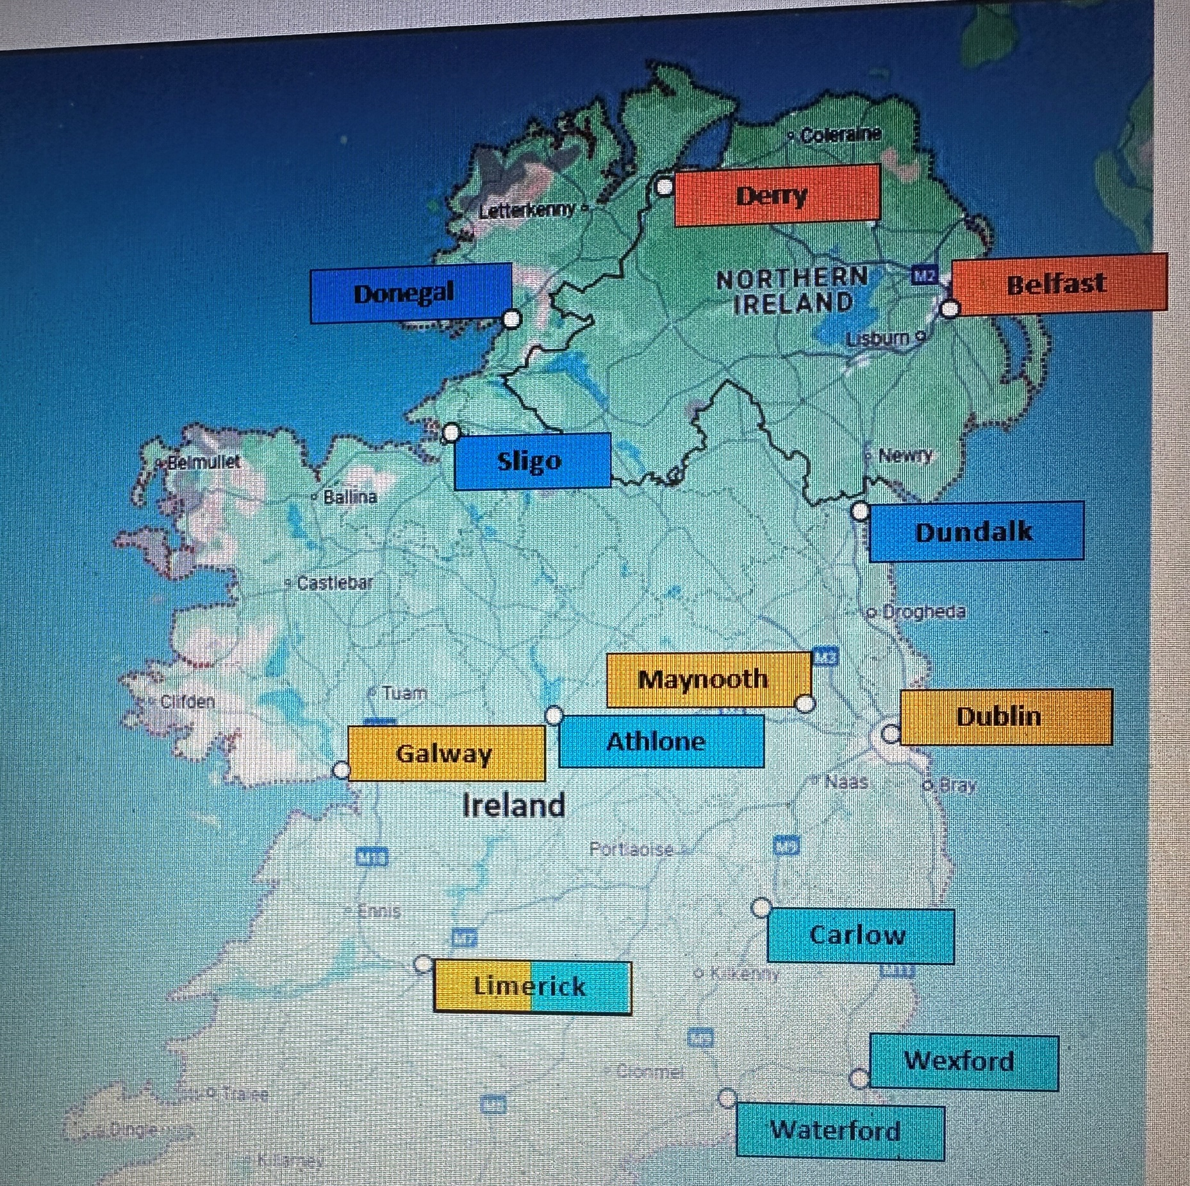
Regional Technological Universities
Dundalk
Donegal
Sligo
Athlone
Limerick
Waterford
Wexford
Carlow

Slide 8
Northern Ireland - Universities
Queen’s University, Belfast (1841): 25K students
Ulster University (1968): 30K students
Jordanstown
Coleraine
Derry
Belfast

Slide 9
NH Business Outreach Opportunities
Universities & institutes hold specialized recruitment and internship fairs for prospective employers
Dublin, Science & Engineering, Sept. 29, 2025
Recruitment of new grad and postgrad employees
Universities have global institutional and enterprise partnerships & networks (e.g., UCD Global Engagement Office)
Construction Jobs Expo, Dublin, May 2025

Slide 10
Thank you!
Q & A/Discussion
Next Steps

