Slide 1

GO-NORTH
State Workforce Innovation Board
Presented By:
Donnalee Lozeau, Director
David Chorney, Director of Financial Sustainability

Slide 2
How We Got Here
Federal Policy Makers:
  Determined they wanted a Transformational long term Sustainable Rural Health Access solution.
  They assigned the task to the Center for Medicare and Medicaid Services (CMS).
  CMS had approximately 70 days to create a Rural Health program to get out to States for a call for applications.
  NH DHHS in cooperation with the Governor had approximately 50 days to respond.

Slide 3
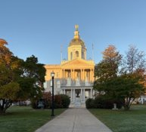
New Hampshire’s Approach to Rural Health Transformation
With the Governor’s office taking lead, public health and Medicaid partnered to support the development of the rural health transformation plan and submission to CMS
Engaged subject matter experts from state and community-based organizations
Formal Request For Information (RFI)
Process with over 200 submissions
Executive Councilors held community sessions and gathered input and provided recommendations for the grant
Meetings with stakeholder groups (e.g., Community Mental Health Centers, Federally Qualified Health Centers, Rural Hospitals, Emergency Medical Service providers, home health agencies, dental organizations, and community-based organizations)
Governor hosted a Rural Health Summit in Littleton New Hampshire with rural providers, community members, and stakeholders to gather input to develop the rural health transformation plan

Slide 4
Governor’s Office of New Opportunities of Rural Transformational Health (GO-NORTH)
Created by the Governor via executive order to meet the transformational moment of the CMS directed Rural Health Transformation grant opportunity.
GO-NORTH is an independent unit under the direct authority of the Governor’s Office.

Slide 5
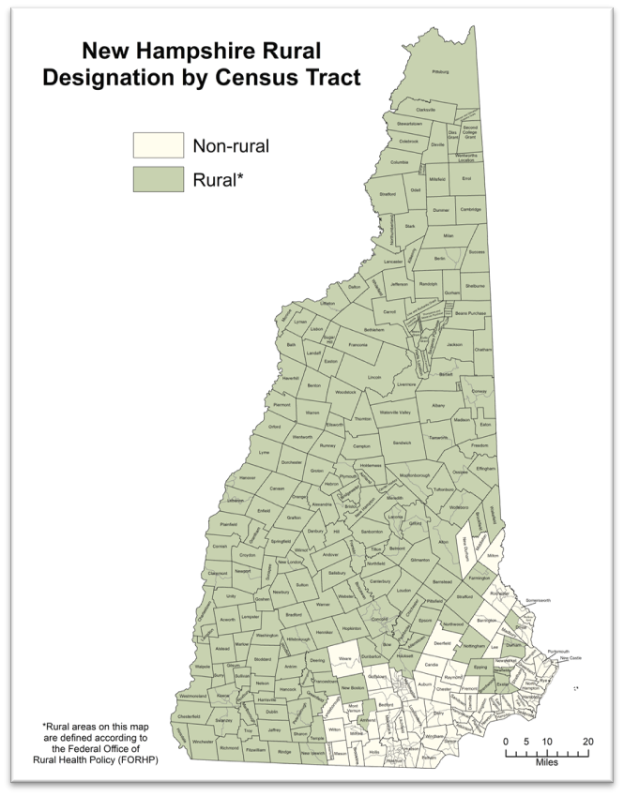
The Reality We’re Facing
Workforce shortages.
Financial pressures on providers.
Access challenges in rural communities.
Rising burden of behavioral health and chronic disease.
Notes:
We’re all seeing the same challenges:
Workforce shortages—especially in rural areas, primary care, and behavioral health.
Rising rates of chronic disease.
Financial strain on providers.
And persistent access challenges across communities.
These are not isolated issues—they’re connected.

Slide 6
The Opportunity
Federal investment of $200 million +/- per year.
5-year transformation effort.
Our success drives our future funding.
Again, we must invest in solutions that endure beyond this grant.
Notes:
This is where the Rural Health Transformation Program comes in.
This is a significant federal investment—over $200 million per year—over five years.
And more importantly, it’s an opportunity to align public health, Medicaid, providers, and community partners around a shared strategy for transformation.

Slide 7
What RHTP Is (and Isn’t)
Is:
Is NOT:
System transformation.
Coordinated approaches.
Focus on outcomes and sustainability.
Cooperative agreement.
Traditional grant program.
Siloed initiatives.
Short-term rescue funding for existing projects.
Payment in a lump sum.
Notes:
It’s important to be clear about what this is—and what it isn’t.
This is not a traditional grant program.
It’s not a collection of disconnected projects.
This is a coordinated, statewide effort focused on long-term system change—improving outcomes, strengthening providers, and building sustainability.

Slide 8
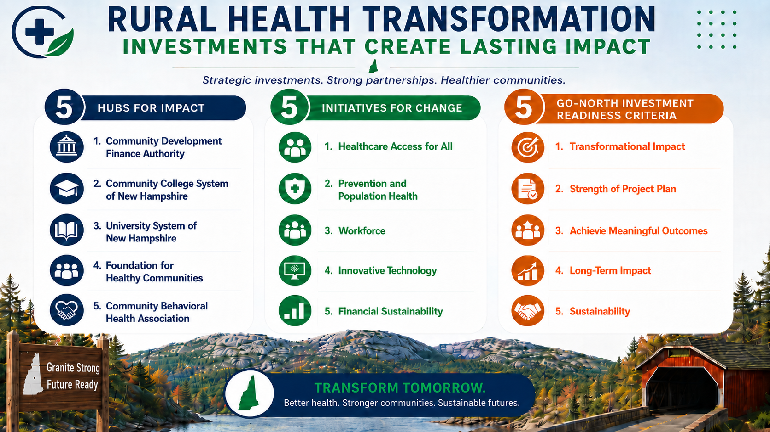
The Model

Slide 9
Initiative 1: Population Health
Key Projects
Regional Capacity for Population Health
Medicaid Duals Polypharmacy
Return-to-work initiative to support a healthy NH Workforce
Presidential Fitness Challenge
Hubs/Contracts/Partners
Foundation for Healthy Communities
Community College System of New Hampshire
RFP Population Health
RFP Medicaid Duals
Dept of Health & Human Services
Dept of Education
Dept of Insurance

Slide 10
Initiative 1: Population Health
Use of Funds Summary
A. Prevention and chronic disease
B. Provider payments
C. Consumer tech solutions
G. Appropriate care availability
K. Fostering collaboration
Total Investment: $265M-$300M
Example Performance Measures
# of preventive and primary care visits
Blood pressure control
Diabetes control
Prevention Quality Indicators
Acute ACSC ED visit rate
Potentially avoidable ED visits
30-day ED revisits potentially avoidable inpatient admissions
Inpatient hospitalization rate
30 days inpatient readmissions
Eligible hospital discharges with medication reconciliation completed before discharge

Slide 11
Initiative 2 - Access
Key Projects
Community Mental Health
Primary Care
Perinatal Care
Advanced Imaging
Specialty Care
EMS
Rural Care Management for Children with Complex Behavioral Health Needs
Non-Emergency Medical Transportation
Hubs/Contracts/Partners
Community Behavioral Health Association
Foundation for Healthy Communities
Community Development Finance Authority
RFP Mobile Imaging
RFP Care Management
RFP Transportation
FQHCs/CAHs/RHCs
Dept of Health & Human Services
Dept of Transportation
Dept of Safety
Dept of Insurance
County operated Nursing Homes

Slide 12
Initiative 2 - Access
Use of Funds Summary
A. Prevention and chronic disease
B. Provider payments
D. Training and technical assistance on technology solutions
E. Workforce
F. IT advances
G. Appropriate care availability
H. Behavioral health
J. Capital expenditures and infrastructure
K. Fostering collaboration
Total Investment: $220M-$275M
Example Performance Measures
Medicaid/dual enrollees who receive a comprehensive medication review
#CCBHCs
CCBHC visits
Preventive dental visits
# of MIH visits
# of peer-to-peer consults

Slide 13
Initiative 3 - Workforce
Key Projects
Dental residency
Family medicine residency
Expanded healthcare careers program
Workforce hub
Common campus for mobile simulation learning
Governor’s Health Scholars Program
Growing rural SUD workforce
Recruiting and retaining eligible organizations provider workforce
Expanded childcare for healthcare workforce
Hubs/Contracts/Partners
Foundation for Healthy Communities
Community College System of NH
University System of NH
Community Behavioral Health Association
Community Development Finance Authority
NH Association of Alcohol and Drug Abuse Counselors
Dept of Health & Human Services
Dept of Business & Economic Affairs
Dept of Labor

Slide 14
Initiative 3 - Workforce
Use of Funds Summary
E. Workforce
F. IT advances
J. Capital expenditures and infrastructure
K. Fostering collaboration
Total Investment: $175M-$275M
Example Performance Measures
# of care coordinators/managers
Licensed LPN/RN
# other paraprofessionals
# licensed RDHs
# of credentialed BH providers
# of pre-licensed BH providers

Slide 15
Initiative 4 - Technology
Key Projects
Regional digital health infrastructure investments to further interoperability and enhanced care coordination
New technology for eligible providers
  Common electronic health records system for CCBHCs
  Electronic dental records system for school-based oral health programs
  Remote patient monitoring
  Telehealth and other tools for communication
Transportation software application to coordinate rural rides for access to care
Hubs/Contracts/Partners
Foundation for Healthy Communities
Community Behavioral Health Association
University System of NH
RFP Transportation
Dept of Health and Human Services
Dept of Transportation

Slide 16
Initiative 4 - Technology
Use of Funds Summary
C. Consumer tech solutions
D. Training and technical assistance on technology solutions
F. IT advances
I. Innovative care
J. Capital expenditures and infrastructure
K. Fostering collaboration
Total Investment: $300M-$400M
Example Performance Metrics
Share of CCBHC/CMHC patients or encounters served by common EMR
Rural EMS/MIH units with TeleEMS
Rural providers with active closed-loop referral system
Rural providers actively using digital health infrastructure for real-time claim authorization and prior authorization workflows

Slide 17
Initiative 5 – Financial Sustainability
Key Projects
Value-based payment readiness
Value-based payment models:
  Hospital payment model
  Children with complex behavioral health needs
  Behavioral health crisis stabilization and transitional housing
  Certified Community Behavioral Health Clinics
Rural Health Capital Improvement Program
Interfacility Transfer Improvement Project
Increase reimbursement for primary care, prevention services, care coordination and care management
Hubs/Contracts/Partners
Community Development Finance Authority
Foundation for Healthy Communities
Community Behavioral Health Association
RFP Hospital Payment Model
RFP Rural Care Management for Children with Complex Behavioral Health Needs
RFP Crisis and Residential
Dept of Health & Human Services
Dept of Insurance
Dept of Safety

Slide 18
Initiative 5 – Financial Sustainability
Use of Funds Summary
B. Provider payments
D. Training and technical assistance on technology solutions
F. IT advances
G. Appropriate care availability
I. Innovative care
J. Capital expenditures and infrastructure
Total Investment: $40M-$75M
Example Performance Measures
Average number of administrative hospital days
Net days in accounts receivable for eligible orgs
Claim denial rate for eligible orgs
# of eligible orgs

Slide 19
What This Means in Practice
More Coordinated Care
Earlier Intervention
Support Beyond Clinical Settings
Better Connection Between Providers and Communities

Slide 20
We Are All Responsible
Five Essential Drivers of Success for Rural Health Transformation
Our collaboration drove NH’s success
We received the highest award amount in New England and we can continue to maximize our federal award through continued collaboration
Spending
Our ability to expend all funds by September 30,2027 for the first Budget Period will garner us redistributed funds from other states who do not expend their awards
Meeting our milestones
NH has committed to key milestones including executing contracts with facilitating organizations before August 2026
Making an impact
Funding will be adjusted based on the impact we have on key metrics- so we need to invest in the right strategies
Long-term success
The success of this program hinges on investments in sustainable and resilient approaches

Slide 21
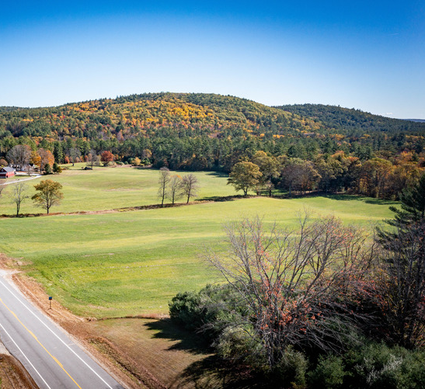
Granite Strong. Future Ready.
Website:
gonorth.nh.gov
General Inquires:
info@go-north.nh.gov
Visit website to self-signup for listserv notifications.
Notes:
We have the resources.
We have the partnerships.
And we have the opportunity.
The question is whether we will use this moment to truly transform how care is delivered in New Hampshire.
Thank you.

