Slide 1
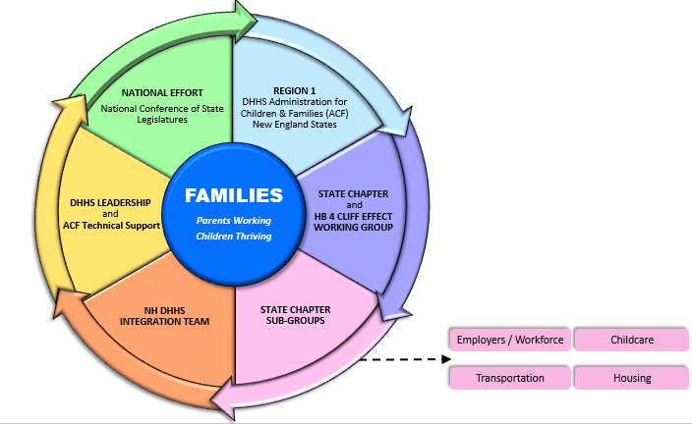
Whole Family Approach to Jobs: Parents Working, Children Thriving
An unprecedented systems coordination to create economic mobility pathways
so families, communities, and businesses thrive!
October 2021

Slide 2
Goals and approach
Support business and disrupt poverty by creating economic mobility pathways in every community
Leverage an evidence-based, multi-generational, integrated framework with families at the center of policy making
Incentivize work, boost individual effort and responsibility while strengthening communities
Promote efficiencies in government and multi-sector partnerships
Participate in a regional and national learning community to accelerate innovation

Slide 3
What is the Cliff Effect
https://www.youtube.com/watch?v=RYqofBF_NBI

Slide 4
Five components
Whole Family Approach to Jobs NH Chapter
DHHS’s Whole Families Integration Team
Benefits Cliff Effect Working Group created by HB 4
Economic Analysis of the cliff effect in New Hampshire
Development of a benefits cliff calculator
https://www.dhhs.nh.gov/ocom/solving-benefits-cliff-effect.htm

Slide 5
Workforce
100% TANF disregard for those working in jobs on the high demand list.
By March 1, 2022, the Department will launch a pilot program with a local automotive dealership to develop a match program towards the purchase of a new or certified preowned vehicle.
By March 1, 2022, the Department will update the TANF State Plan and amend the administrative rules to change the TANF disregard and expand the education requirements allowed.
By September 2022, the Department will develop a Request for Proposal for a post-TANF Support Program.

Slide 6
Food Security
By March 1, 2022, increase the SNAP Gross Income limit. This will require approval by the NH Legislature’s Health and Human Services Oversight Committee.

Slide 7
Child Care
Immediately, the Department will target a portion of the federal child care relief dollars to provide to businesses to support child care in local communities.
By September 30, 2021, the Department, using federal child care relief dollars, will pilot a temporary increase of eligibility for the New Hampshire Child Care Scholarship to determine if this increases the number of families eligible for assistance.
By September 30, 2021, the Department, using federal child care relief dollars will raise state payment rates for non-traditional hours.
By January 31, 2022, the Department will amend the administrative rules to adjust the steps within the NH Child Care Scholarship Program.
By January 31, 2022, the Department will make recommendations regarding enrollment based child care payments. The Department will work together with a workgroup that includes, but is not be limited to representatives from: the Whole Families Approach to Jobs Chapter, Child Care Advisory Council Executive Team, stakeholders, parents, and child care providers.

Slide 8
Cliff Calculator
Will be live later this fall. Online and mobile.
Tool for individuals to determine how wages impact their benefits and ultimately their family.
Important as they make the decision to take a job, increased hours, or a pay increase.
Tool is also important for the Case Managers that are working with the individual seeking employment.
Partnering with Federal Reserve Bank of Atlanta to complement the calculator to include:
A planner for Individuals
Policy level information

Slide 9
Questions/Discussion

Slide 10
“We envision an easily accessible, integrated system that feels seamless to families, meets them where they are at, strengthens parents capacity to work and supports the healthy development of their children and family”. (NH WFATJ Chapter 2019)

